Slide 1

Stereotypes: Prejudice and Discrimination
AEPSY Year 11 ATAR Psychology

Slide 2
Review
State one advantage and one disadvantage of convenience sample as a method for selecting participants for a study.
Explain the purpose of a Likert scale.
Which graph(s) are most suitable for frequency data.
For an experimental study, explain the difference between a controlled variable and a control group.

Slide 3
Learning Intentions
stereotypes as a form of social categorisation:
relationship between attitudes, prejudice and discrimination
distinguish between prejudice and discrimination
direct and indirect discrimination
examples of prejudice and discrimination in society – gender, race, ethnicity, age, disability, mental illness

Slide 4
Success Criteria
Distinguish between attitude, prejudice and discrimination, using the tripartite model.
Classify examples as direct or indirect discrimination.
List at least 6 examples of prejudice/discrimination in society.

Slide 5
Stereotypes, Prejudice and Discrimination
Social Bias consists of three aspects: stereotypes, prejudice and discrimination, which are all interrelated, but can occur individually.
Emotions are a strong component of attitudes, therefore stereotyping and prejudice can become a concern if emotions are so strong that they develop into unjust behaviours towards members of an outgroup (discrimination).

Slide 6
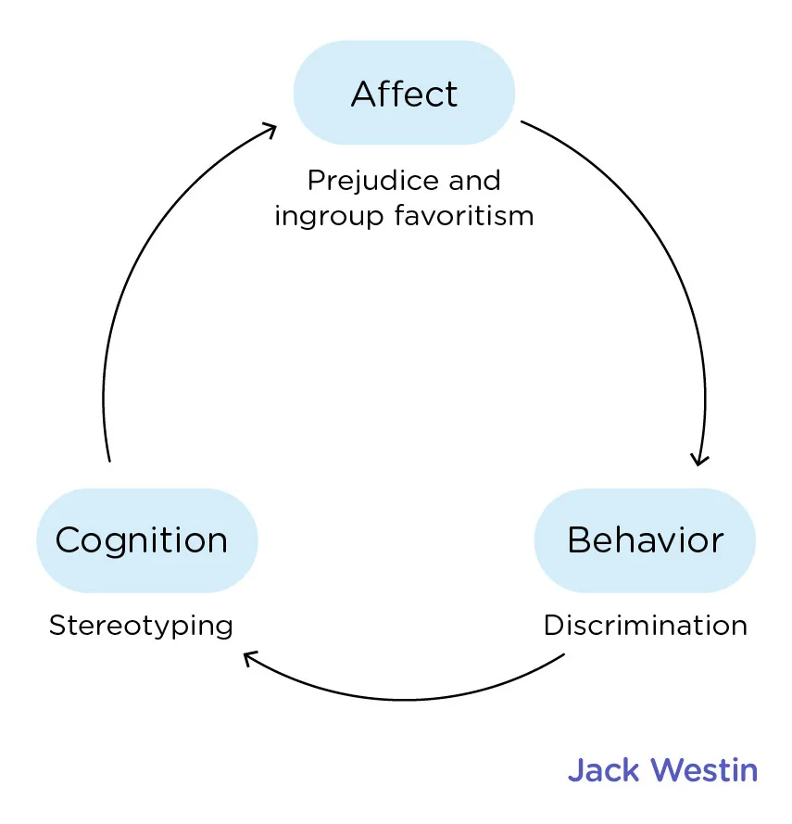
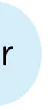
The tripartite model
can be used to explain the relationship between social categorisation, prejudice, stereotypes and discrimination.
Behaviour

Slide 7
Prejudice
Social categorisation can lead to prejudice, which is negative feelings towards members of an outgroup.
Prejudices are unjustified attitudes towards members of social groups, with a focus on the affective component of attitude.

Slide 8
Prejudice does not inevitably lead to discrimination; an individual can discriminate against a group of people without holding negative feelings towards them, eg a shop assistant could deny entry to a person with an assistant dog, because dogs are not allowed in their store. They are discriminating based on a disability, but may have not negative emotions towards people with disability at all.

Slide 9

Discrimination
Discrimination involves only the behaviour aspect of attitude. Holding overgeneralised stereotypes, whether positive or negative, can lead to acts of discrimination. Negative feelings or attitudes only develop into discrimination if acted upon. These acts can often reinforce stereotypes.

Slide 10
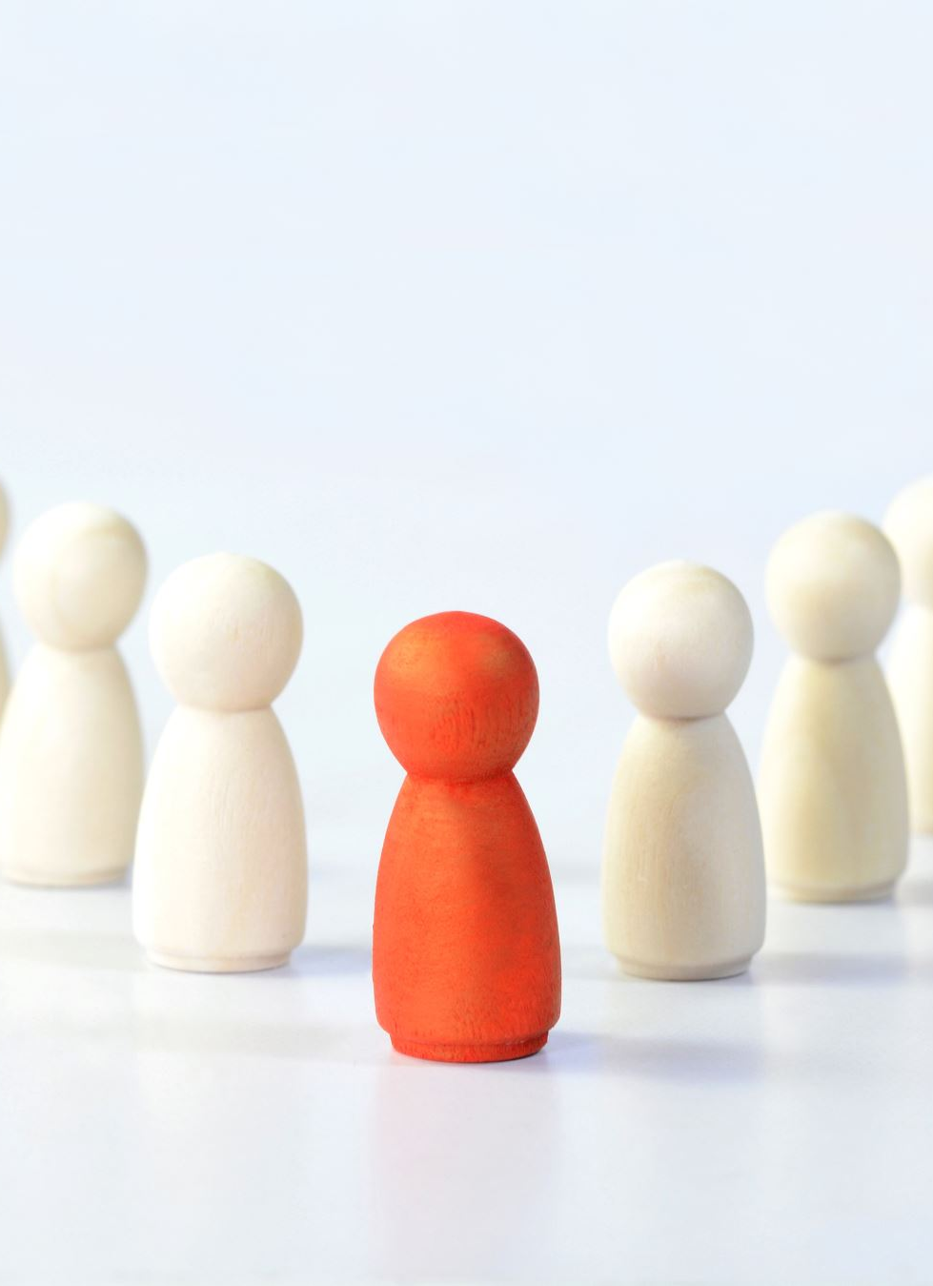
Direct Discrimination
Occurs when an individual is treated unfairly because of a characteristic they have or are assumed to have.
Direct discrimination is intentional.

Slide 11
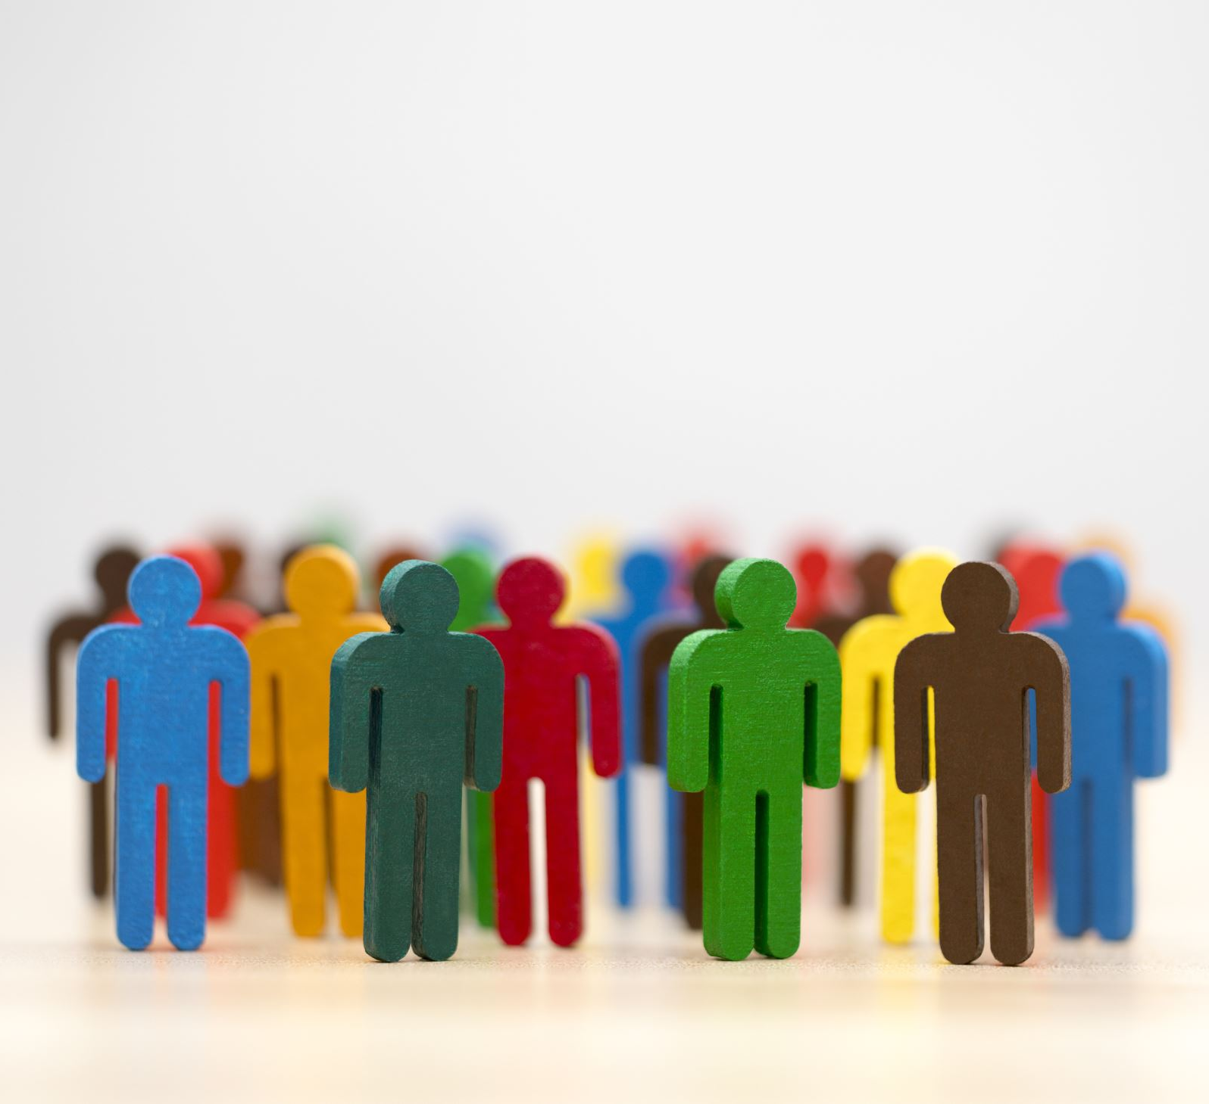
Indirect discrimination
Occurs when individuals who have a particular characteristic are unfairly disadvantaged due to conditions or regulations that apply to everyone.
Indirect discrimination is often unintentional.

Slide 12
Discrimination case studies
Determine type of discrimination
Classify as direct or indirect

Slide 13
Types of Discrimination
Discrimination case studies Types of Discrimination

Slide 14
Success Criteria
Distinguish between attitude, prejudice and discrimination, using the tripartite model.
Classify examples as direct or indirect discrimination.
List at least 6 examples of prejudice/discrimination in society.

